Slide 1
AI & Machine Learning
AI Introduction & Python Foundations
Dr. Tariq Sadad

Slide 2
Python Core Concepts for AI
Python is the foundation of AI and ML
Before models, we must understand data and logic
Today we cover essential Python concepts used in AI
Strong Python → Easy AI

Slide 3
Variables – Storing Information
Variables store data in memory
  name = "Ali"
  age = 21
  cgpa = 3.5
String → text
Integer → whole number
Float → decimal number

Slide 4
Updating Variables
Updating Variables
  age = 22
  print(age)
Variables are called variables because their values vary

Slide 5
Lists – Multiple Values Together
Lists – Multiple Values Together
  subjects = ["Math", "Physics", "Computer", "English", "AI"]
Index starts from 0
Ordered collection
Access, add, and remove elements from list
  subjects[0] # First item
  subjects[-1] # Last item
  subjects.append("ML")
  subjects.remove("English")
Lists are flexible and dynamic

Slide 6
Dictionaries (Maps)
Key–Value data structure
  student = {
  "name": "Sara",
  "roll_no": 101,
  "marks": 85
  }
Key → Meaning
Value → Data
Used for real-world records

Slide 7
Updating Dictionary Data
  student["marks"] = 90
  student["grade"] = "A“
Values can be updated
New keys can be added
Dictionaries grow with data

Slide 8
Tuples – Fixed Data
Tuples are immutable (cannot change)
  cities = ("Mardan", "Peshawar", "Swat")
Similar to list
Used for constant data
Safe and fixed structure

Slide 9
Sets – Unique Values Only
Sets – Unique Values Only
  numbers = {1, 2, 3, 3, 4}
No duplicates
Unordered collection
Best for unique data

Slide 10
Control Flow – if–else
Programs make decisions using conditions
  if marks >= 80:
  print("Pass")
  else:
  print("Fail")
Decision-making is intelligence

Slide 11
Grading with if–elif–else
  if marks >= 90:
  grade = "A"
  elif marks >= 80:
  grade = "B"
  elif marks >= 70:
  grade = "C"
  else:
  grade = "F“
Multiple conditions handled logically

Slide 12
Loops – Repeating Tasks
Loops – Repeating Tasks
  for i in range(1, 6):
  print(i)
Repeats code
Saves time
Used for large datasets

Slide 13
While Loop
  count = 5
  while count > 0:
  print(count)
  count -= 1
Runs until condition becomes false
Controlled repetition

Slide 14
Imports – Python Power
  import math
  import datetime
Libraries extend Python capabilities
AI depends on libraries

Slide 15
TASK 1: NumPy Arrays (Numbers)
Objective
  Understand how AI works with numerical data using NumPy arrays.
Task
  Create a NumPy array with the values: 5, 10, 15, 20, 25
  Print the array
Find:
  Sum
  Mean
  Maximum value
Starter Code
  import numpy as np
  arr = np.array([5, 10, 15, 20, 25])
  print(arr)
Expected Output (Example)
  [ 5 10 15 20 25 ] Sum: 75 Mean: 15.0 Max: 25

Slide 16
TASK 2: Pandas DataFrame (Tables)
Objective
  Work with tabular data (rows & columns) like Excel.
Task
  Create a DataFrame with:
    Student Name
    Age
    Marks
  Print the DataFrame
  Display only the Marks column
Starter Code
import pandas as pd
data =
{ "Name": ["Ali", "Sara", "Ahmed"], "Age": [20, 21, 22], "Marks": [85, 90, 78] }
df = pd.DataFrame(data)
print(df)

Slide 17
Reality of Real-World Data
Real Data Is NOT Clean
  Missing values
  Wrong formats
  Duplicate rows
  Inconsistent labels
AI models fail because of bad data, not bad algorithms

Slide 18
Loading a Real CSV
Code
import pandas as pd
df = pd.read_csv("StudentsPerformance.csv")
df.head()
Explain
CSV → real-world dataset
head() → quick inspection
Teaching line
“Never trust data before seeing it.”

Slide 19
Understanding the Dataset
  df.shape
  df.columns
  df.info()
  df.describe()
Explain Simply
shape → size of data
columns → features
info() → data types & missing values
describe() → statistics

Slide 20
Data Cleaning
“If you can clean and visualize data, AI becomes easy.
Common Cleaning Tasks
  df.isnull().sum() % Finds missing values in the dataset.
  df.dropna() % Removes rows that contain missing values.
  df.fillna(0) %Replaces missing values with 0.
  df.duplicated().sum() % Counts duplicate rows in the dataset.

Slide 21
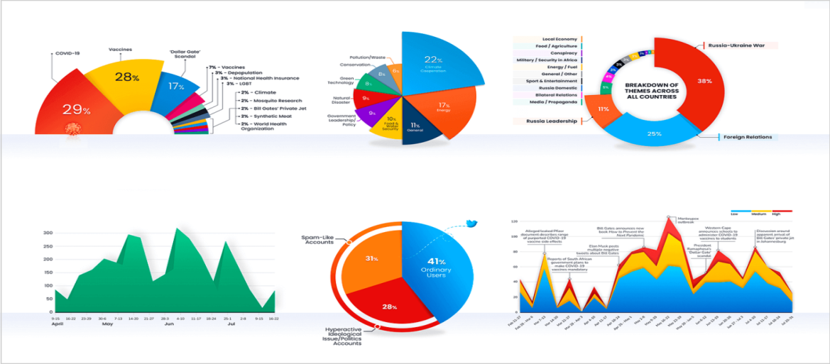
Why Visualization Matters
Why Numbers Are Not Enough
  Tables are boring
  Humans understand pictures
  Patterns are easier to see
  “Visualization turns data into insight.”

Slide 22
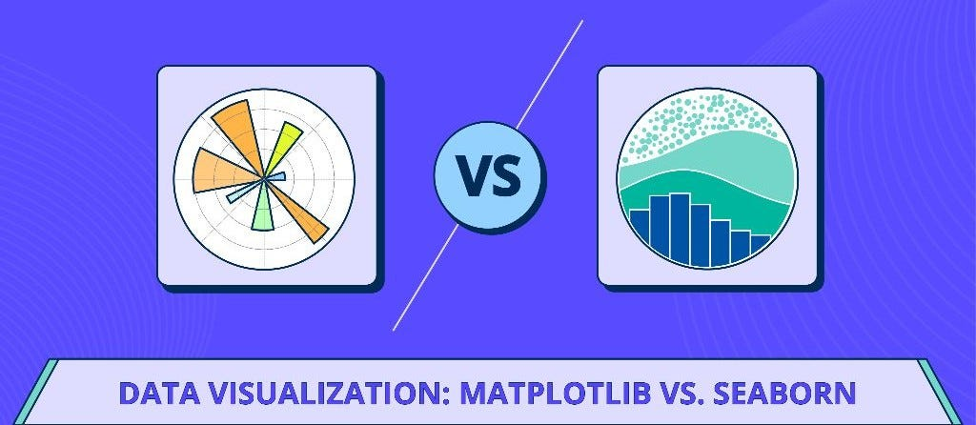
Visualization Tools in Python
Tools
  Matplotlib → basic plots
  Seaborn → beautiful plots
Both are used together
Memory Line
  Matplotlib = control
  Seaborn = beauty

Slide 23
First Plot (Matplotlib)
import matplotlib.pyplot as plt
df['math score'].plot(kind='hist')
plt.show()
Explain
  Distribution of scores
  Where most students lie

Slide 24
Seaborn for Storytelling
import seaborn as sns
sns.boxplot(x='gender', y='math score', data=df)
Explain
  Comparison between groups
  Hidden patterns
Teaching line
  “Good plots answer questions without text.”

Slide 25
Automated EDA (Preview)
“Instead of writing many plots, let Python do it automatically.”
from pandas_profiling import ProfileReport
profile = ProfileReport(df)
Profile
This is an automated EDA dashboard

Slide 26
LAB TASK 1: Data Cleaning
Task
Load a CSV dataset
Check missing values
Handle missing data
Remove duplicates
Dataset: Any Kaggle CSV

Slide 27
LAB TASK 2: Exploratory Data Analysis
Task
  Show dataset shape & columns
  Use describe()
  Identify one insight
Write insight in words

Slide 28
LAB TASK 3: Visualization
Task
Create:
  Histogram
  Boxplot
  Bar chart
Compare two categories
Use Matplotlib + Seaborn

Slide 29
LAB TASK 4: Mini EDA Dashboard
Task
Generate automated EDA report
Export or show report

